Slide 1
Unpaired t-test

Slide 2
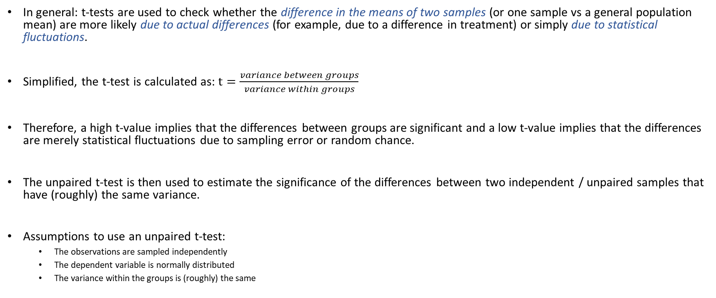
Explanation
In general: t-tests are used to check whether the difference in the means of two samples (or one sample vs a general population mean) are more likely due to actual differences (for example, due to a difference in treatment) or simply due to statistical fluctuations.
Simplified, the t-test is calculated as: $t=\frac{variance between groups}{variance within groups}$
Therefore, a high t-value implies that the differences between groups are significant and a low t-value implies that the differences are merely statistical fluctuations due to sampling error or random chance.
The unpaired t-test is then used to estimate the significance of the differences between two independent / unpaired samples that have (roughly) the same variance.
Assumptions to use an unpaired t-test:
The observations are sampled independently
The dependent variable is normally distributed
The variance within the groups is (roughly) the same

Slide 3
Unpaired t-test: Real life example
Compare the average height of individuals grouped by gender: male and female groups, which are two independent groups.
Data set extracted from: https://www.kaggle.com/mustafaali96/weight-height
The dataset contains weight and height data by gender.
The assumptions done on the datasets are:
Both height distributions are normal distributions
There are no big amount of outliers
The variances are assumed equal in order to use the Unpaired t-test

Slide 4
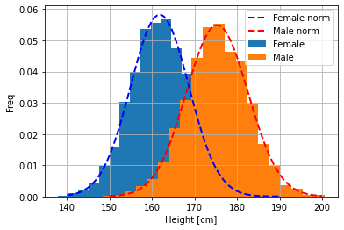
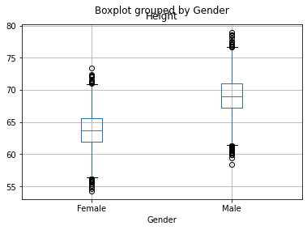

Unpaired t-test: Real life example
Figure 3
Figure 1
Figure 2
As shown on Figure 1 both variables fit well into a normal distribution.
In Figure 2 the outliers are shown, considering the dataset contains 10k entries is assumed to be good enough.
In Figure 3 the variance of both variables is shown. Unpaired t-test will be used.

Slide 5

Unpaired t-test: Real life example
Considering the hypothesis:
Since p-value is 0 we reject the null hypothesis concluding that the two mean values for the two variables are different.
$$H_{0}:m_{Male}=m_{Female}$$

Slide 6
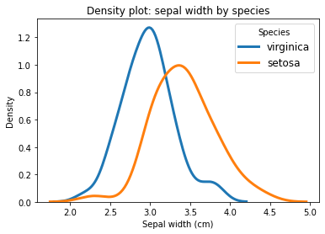

Unpaired t-test (aka. independent t-test)
Comparison of sepal width of virginica and setosa species.
Unpaired t-test with equal variance assumption indicates that we can reject the null hypothesis of equal width with p < 0.01. Most likely, these samples do not come from a population with same mean and variance.
D’Agostino and Pearson’s tests (p=0.28 and p=0.39) as well as Shapiro-Wilk tests (p=0.18 and p=0.20) suggest normal distribution for both variables.

